Slide 1
2024-2025
Athletic Informational Meeting
Presented by: Ms. Butcher Athletic Director

Slide 2
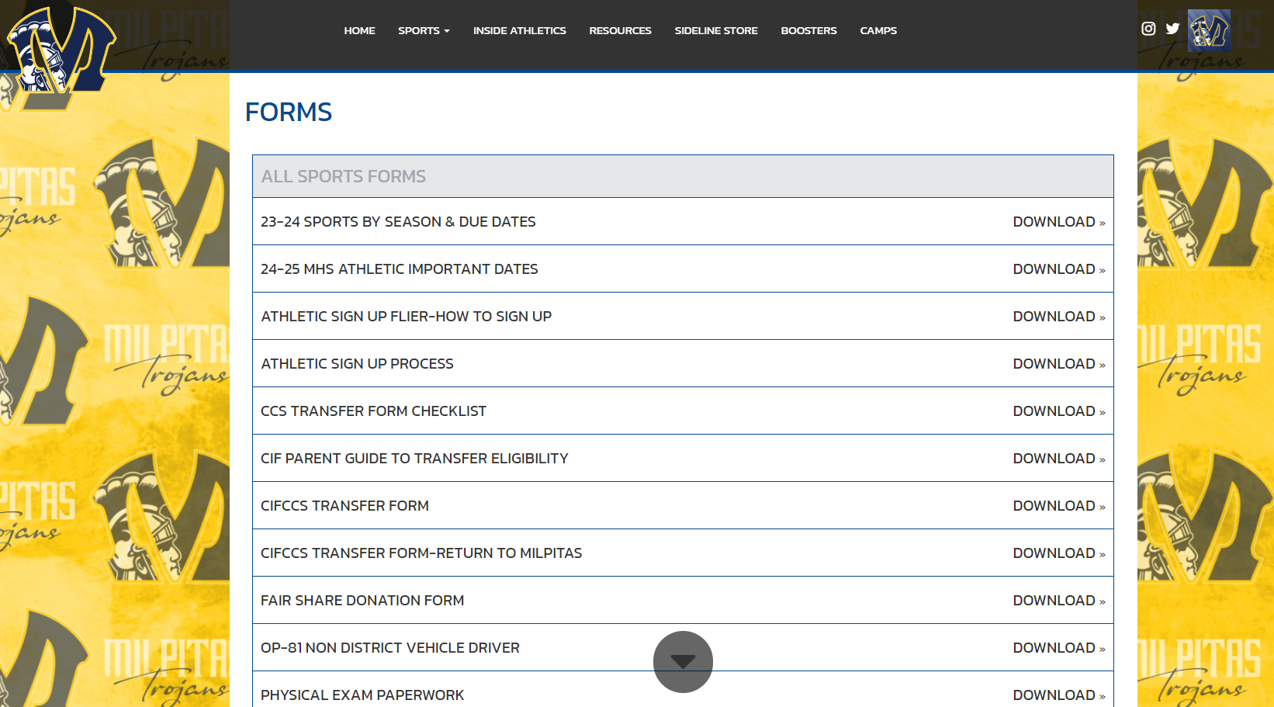
MHS Athletics Website
https://www.mhstrojanathletics.com/
Notes:
https://www.mhstrojanathletics.com/sport/golf/girls/

Slide 3
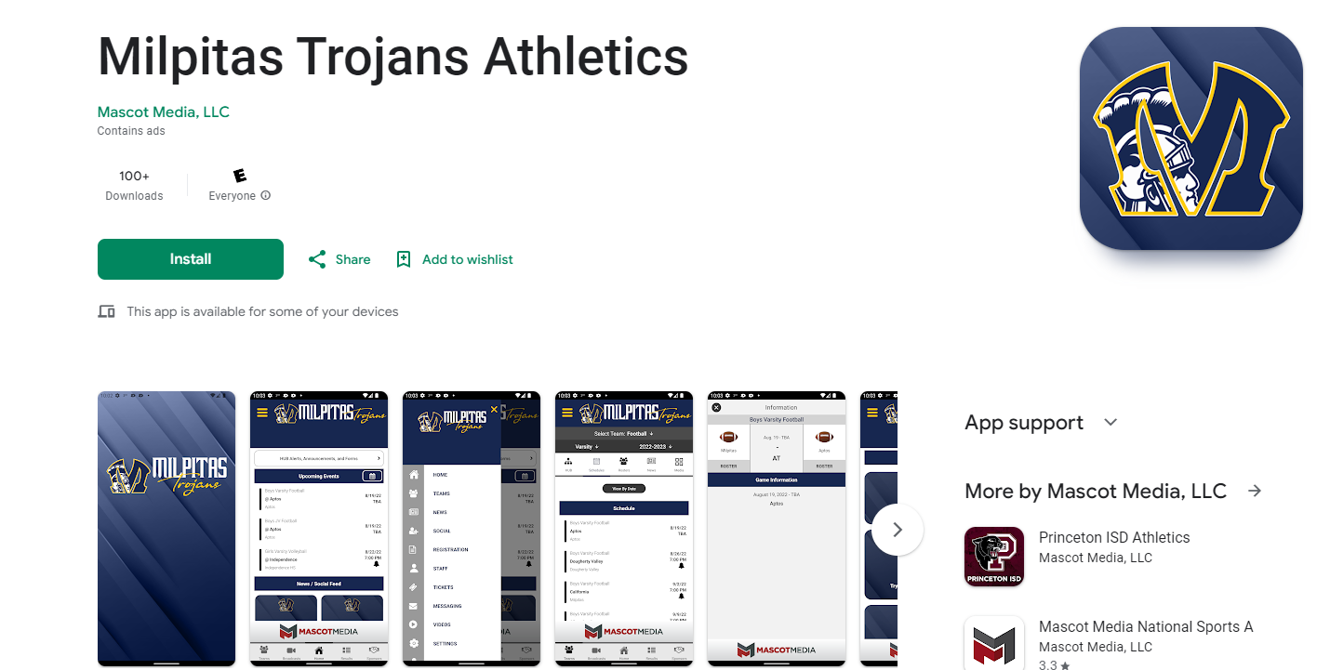

Slide 4
High School Sports
Practice is 5-6 times a week up to 3 hours per day
Facility space is limited-it is possible to practice 7:30-9:30pm
Practice and/or contests WILL occur on vacation days
Going on vacation is not excused and expect to lose playing time
Playing time is not guaranteed
Seasons overlap
How to they differ from club or middle school?
Notes:
To be clearer: Depending on the sports their will be practice during EVERY break we have: Thanksgiving, Winter, Ski Week, Spring Break.

Slide 5
Fall Sports
8/9-11/9 (not including Varsity Sport Playoffs)
Fall Sports
Cross Country
Girls Flag Football
Football *8/5
Girls Golf
Girls Tennis
Girls Volleyball
Boys Water Polo
Girls Water Polo
Paperwork Due to P-12
August 5, 2024
Guardian/Athlete Mtg
August 6, 2024
MHS Gym in person 6:30-8pm
Practice Starts
August 9, 2024
School Starts
August 15

Slide 6
Winter Sports
11/4-2/19 (not including Varsity Sport Playoffs)
Winter Sports
Boys Basketball
Girls Basketball
Boys Soccer
Girls Soccer
Wrestling
Paperwork Due
October 23, 2024
Guardian/Athlete Mtg October 29, 2024
MHS Gym in person 6:30-8pm
Practice Starts
November 4, 2024

Slide 7
Spring Sports
2/3-5/17 (not including Varsity Sport Playoffs)
Spring Sports
Badminton
Baseball
Boys Golf
Softball
Swimming
Boys Tennis
Track & Field
Boys Volleyball
Paperwork Due
January 22, 2025
Guardian/Athlete Mtg January 27, 2025
MHS Gym in person 6:30-8pm
Practice Starts
February 3, 2025

Slide 8
Season 1 Team Season 2 Teams OVERLAP
Tryouts- Athletes in a Season 1 Sport MUST communicate with the Season 2 Coach regarding trying out for the sport.
You are not guaranteed to receive 3 days of tryouts after Season 1 ends without communication with a Season 2 Coach
Home Campus CONFIRMATION SEASON 2 SPORT (Physical and Concussion Paperwork already on file)
Notes:
Paperwork is good the entire school year. Send an email or face to face meeting from the athlete. You must get a new physical every year you compete.

Slide 9
Must have 2.0; passing 4 classes
Sports eligibility will be based off of 6 week grades to tryout/practice.
Entire SCHOOL graded at the same time.
Continuing eligibility will be based off next grading period
Eligibility
Notes:
This is unweighted gpa. It has to be consistent for every athlete. If an athlete had 5 C’s & 1 C- and we used weighted gpa’s the athlete would then be INELIGIBLE. Incoming 9th graders have a free pass for the first 6 weeks. Everyone else will use the 2nd semester grades for the Fall sports. We do not have a probation period at MHS. Teams that cut MAY NOT keep someone who is ineligible over someone who is eligible. They may NOT be added to the team later in the season either.

Slide 10
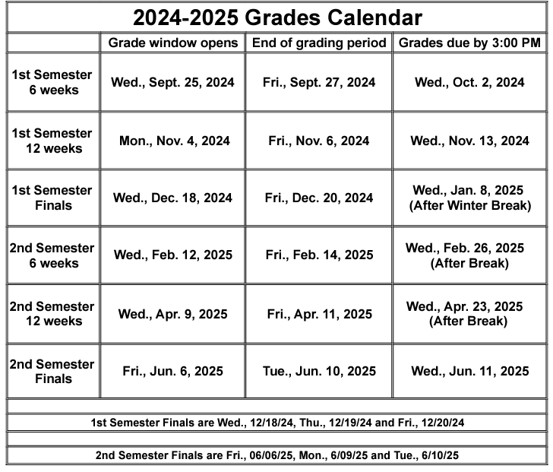
WED
Wed
Notes:
Winter sports will use the 6 week grading period from the beginning of school to determine the gpa eligibility; Spring Sports will use the 1st semester grading period to determine gpa eligibility. It is possible to be on the roster and later become ineligible. There are some sports that are non-cut unless excessive absences or safety issues. An athlete could be on the roster for cross country and continue to practice until the eligibility period changes. They will not be able to compete until they are cleared status from the Athletic department.

Slide 11
Residential Eligibility for Athletic Eligibility CIF / CCS Requirements
Transfer students- must be cleared before competition. If you were not enrolled for the last 12 months at Milpitas High you are a transfer student you need to contact Athletic Director. Visit CIFCCS.org
This does not include current 9th graders who started MHS on 1st day of this school year.

Slide 12
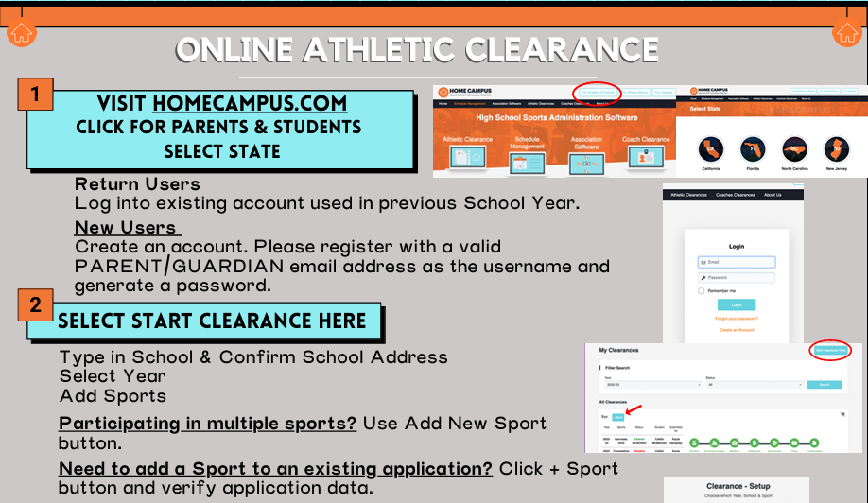
Notes:
https://www.youtube.com/watch?v=eKivobMSmEE

Slide 13
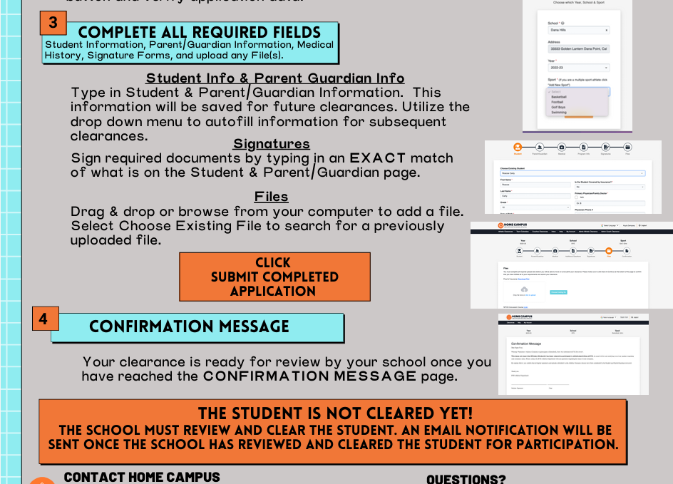
CONFIRMATION Page is required to be submitted with wet signatures to the Athletic Office, P-12 or lock box outside P-12 office.
Notes:
Wet signatures are required. We have had students sign up for sports without their guardians permission. This is our double check for liability reasons.

Slide 14
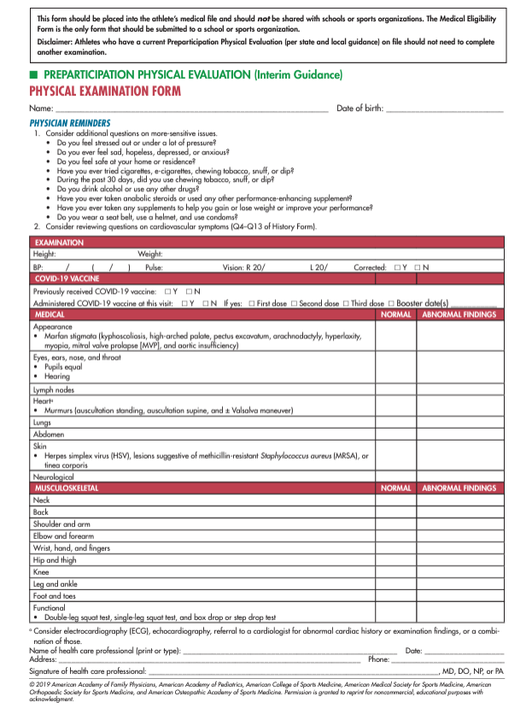
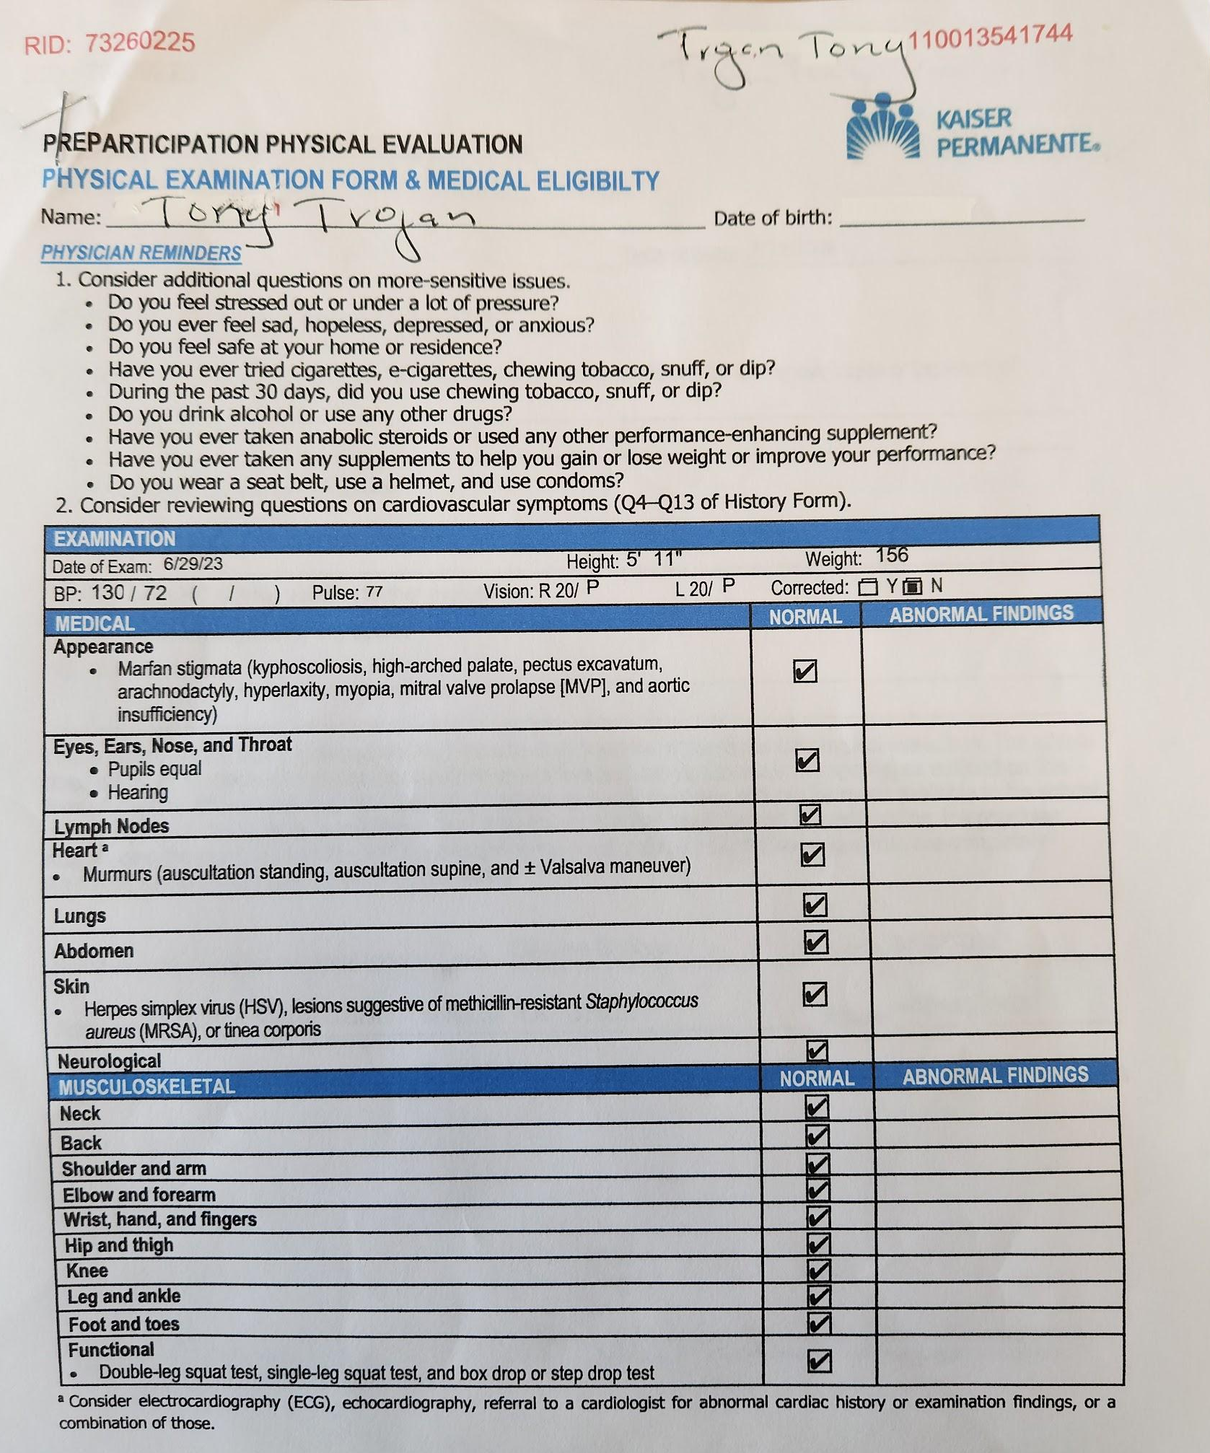
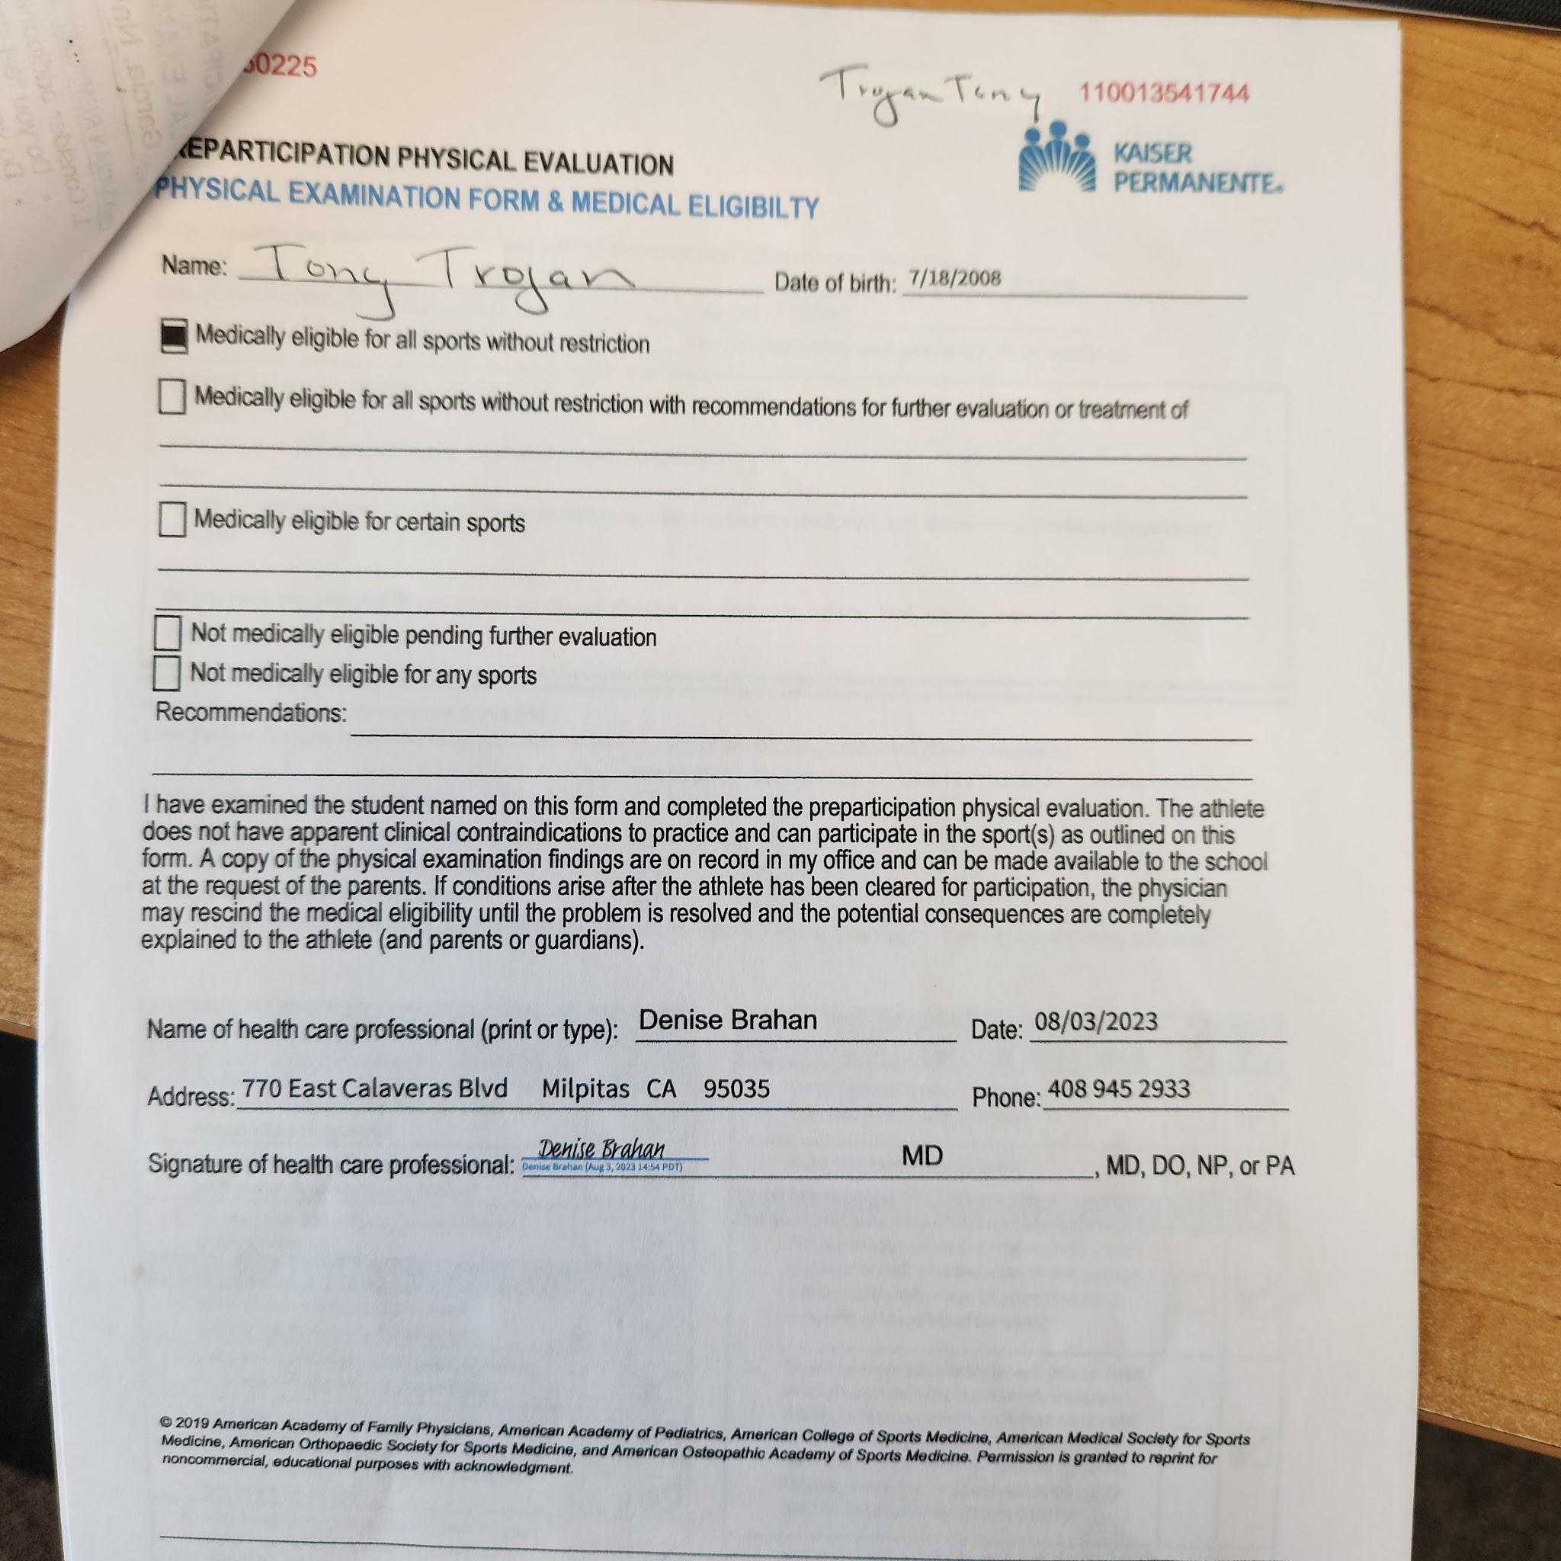
Physical Exam Requirements 24-25
June 2nd $30 9am-1pm; July 28th $30 9am-1pm cash
Notes:
After june 1, 2024 may take a physical exam and submit to athletic office. Signup will be sent out soon. Must have history completed and signed before the Doctor may see you. These are the ONLY acceptable forms to submit. This is the CIF approved physical exam paperwork. Child wellness exam is DIFFERENT than a sports physical. One per year. This is liability concerns.

Slide 15
Physical Exams
PAPER PHYSICAL EXAMS MUST BE SUBMITTED TO P-12, ATHLETIC OFFICE.
No trainer to review these
Website does not notify athletic office of updated forms
Pictures are difficult to read
Guardians have locked the forms which does not allow viewing
DO NOT UPLOAD to home campus
Notes:
Must be stamped by the doctor’s office. It’s not necessary to upload. You may upload YET you must still a paper copy to the Athletic Office. Pictures don’t show when someone tries to change the date.

Slide 16
Insurance Requirements

Slide 17
What do we turn in to Athletic Office?
Home Campus Confirmation Page
Physical Exam 2 page document
After June 1, 2024
STAMPED by the Doctor’s Office
Completed and checked eligible for all activities
Student Name and ID # on the main form (Legible please)
History pages are optional
Notes:
History questions are in home campus

Slide 18
Clearance Process
Create an account on home campus & submit confirmation page to Athletic Office.
Physical Exam paperwork submitted to Athletic Office
Paperwork is reviewed and will receive
Practice only-information about the mandatory meeting will be sent
Grades, mandatory meeting, fair share, roster=clearance status
In progress-have not completed the electronic process
Pending-has NOT be reviewed by Athletic Office
Denied-an email will be sent with the details of what is missing
Attend the Mandatory Guardian AND Athlete Mtg; sign in at end
Make the team roster
2.0gpa or higher (unweighted)
Fair Share Donation (paypal, cash, check, or paper signed for zero donation)

Slide 19
Notes:
Notice the dates that these are sent; I have a record from here that notes when it is sent to the users.

Slide 20
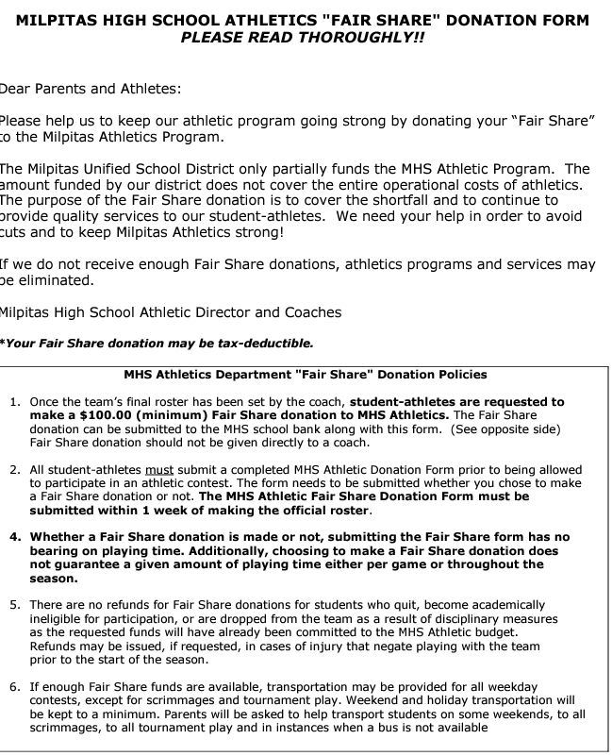
“Fair Share” Donations
Athletic Budget is entirely self funded
Ticket sales for home games
Football, Volleyball,Basketball, Wrestling
Donations from Guardians
Sponsorship from local businesses
Company Matching funds
Rebates
Officials, Security, Equipment,
CIF/CCS/SCVAL Fees, reconditioning
Notes:
It is not required and families may opt out of donating to support athletics

Slide 21
Breakout Rooms
Breakout rooms: you should be able to move in and out of rooms.
Coaches introductions
Link to FAQ
The zoom meeting will end by 730pm. Please email jbutcher@musd.org to have additional questions answered.
You may leave at any time

